Slide 1

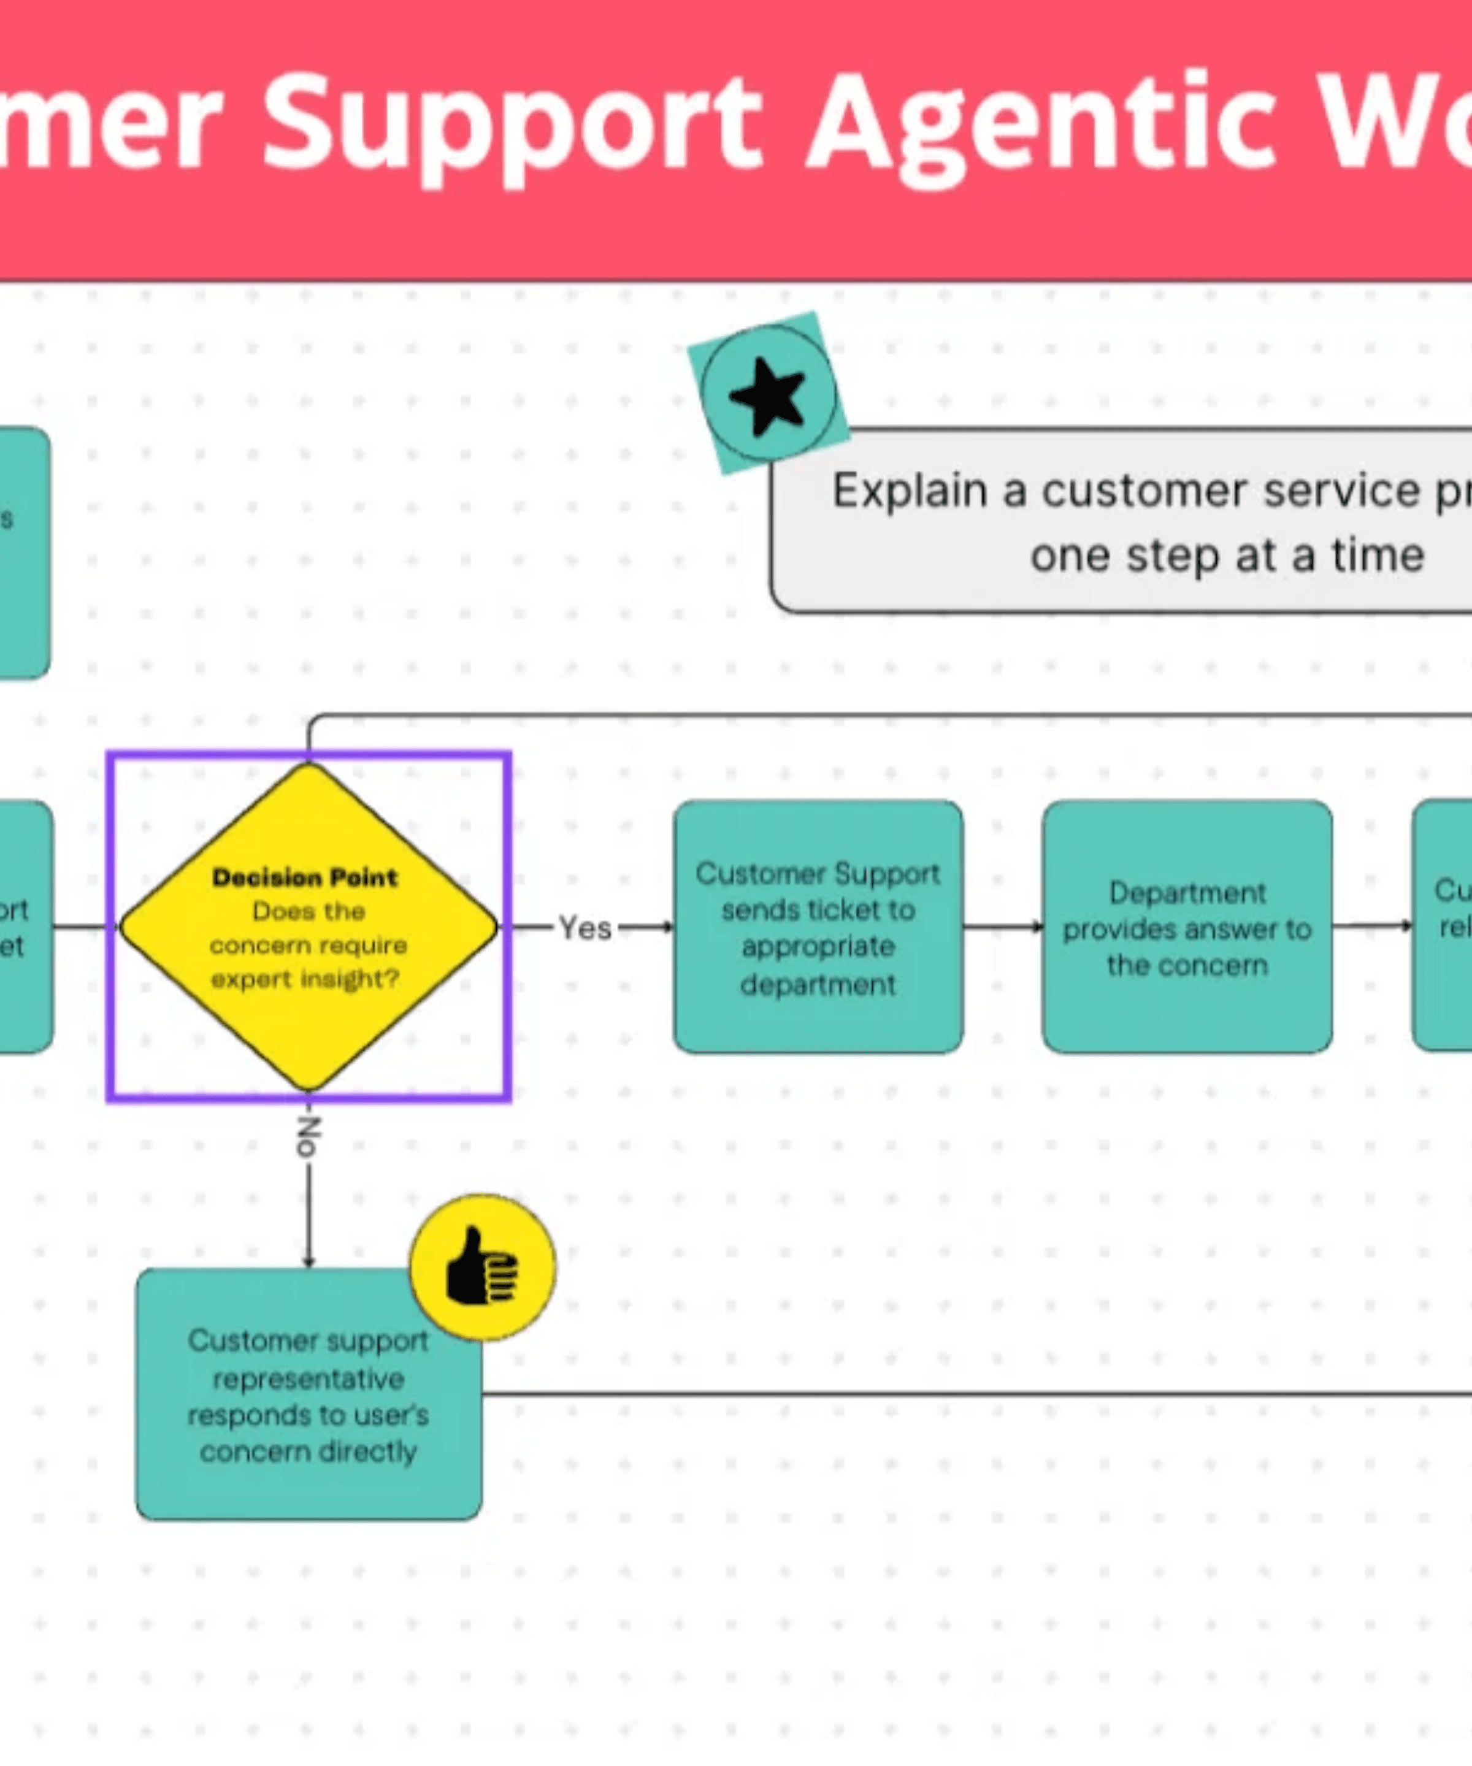
Agentic AI
Workflows &
Components
Mastering the Architecture of Autonomous Intelligence
Eng/ Mohamed Khaled Idris

Slide 2

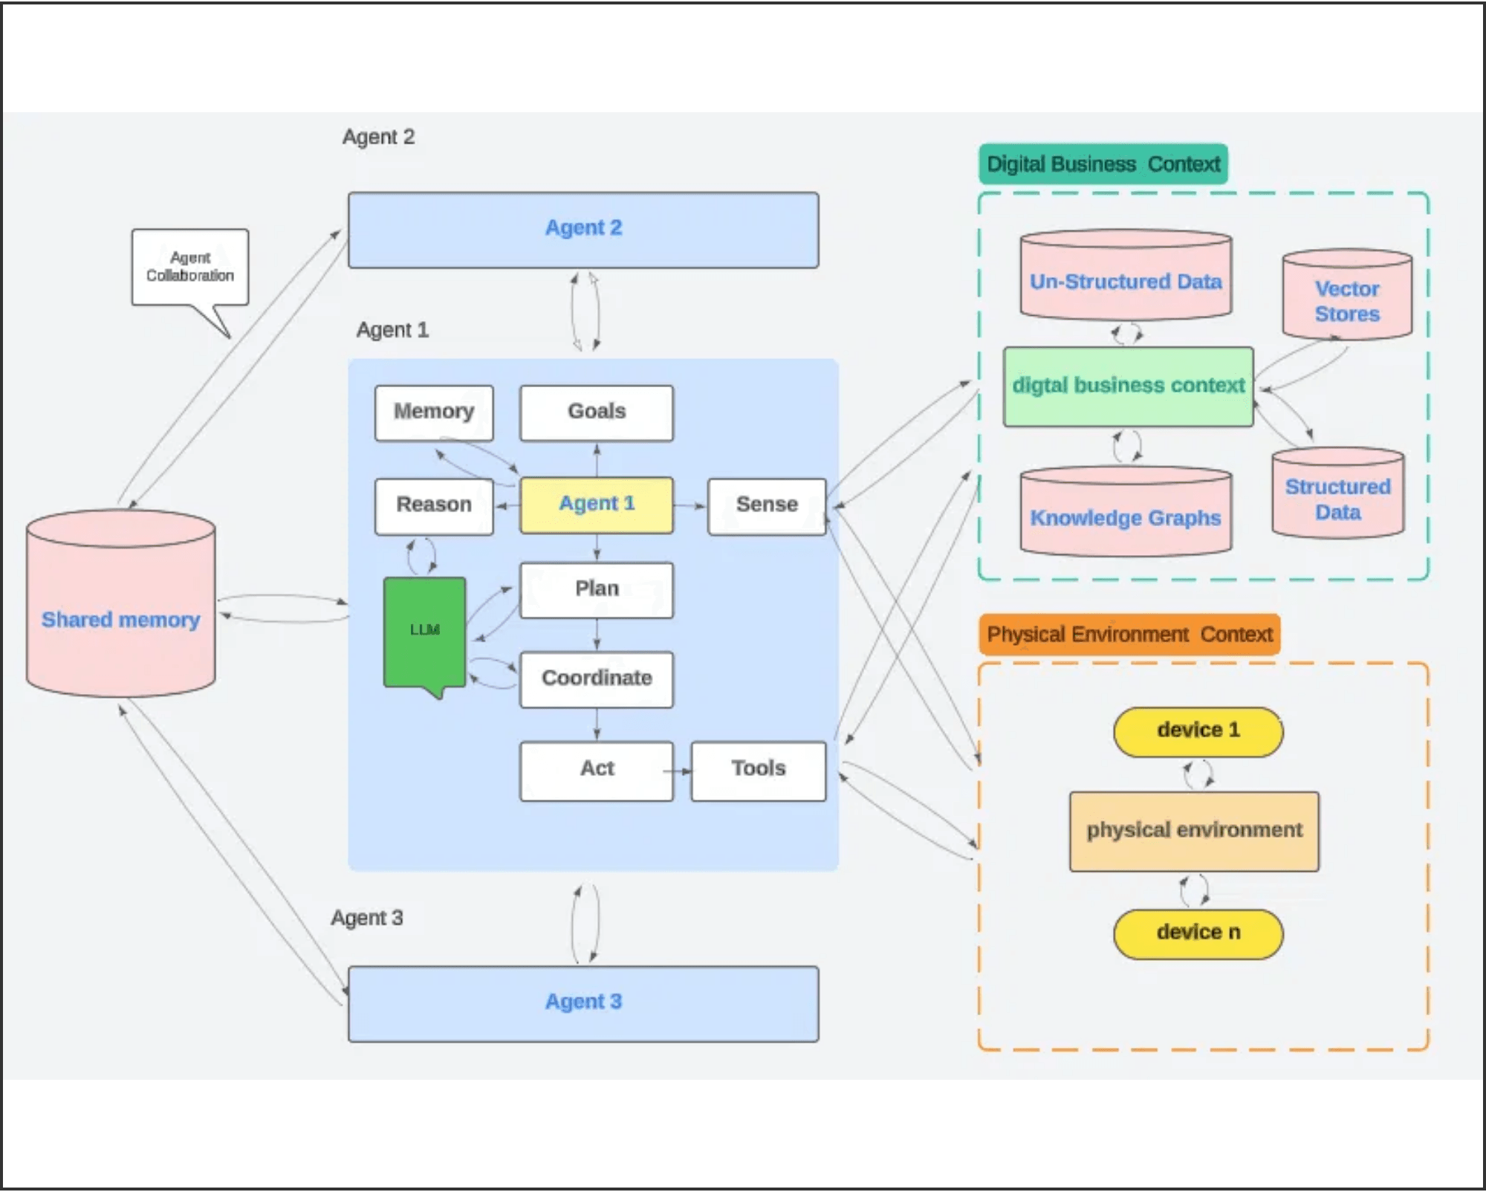
Agentic Workflows Transform Passive Models into Active Problem Solvers
Beyond One-and-Done
Traditional Generative AI operates on a single-turn basis. Agentic AI introduces autonomy and iteration, allowing systems to reason and plan independently.
The Feedback Loop
The core difference lies in the feedback loop: agents observe the results of their actions and dynamically adjust their strategy to achieve the goal.
Advisor to Operator
This evolution moves AI from a simple "advisor" role to an "operator" capable of completing end-to-end business processes with minimal intervention.

Slide 3
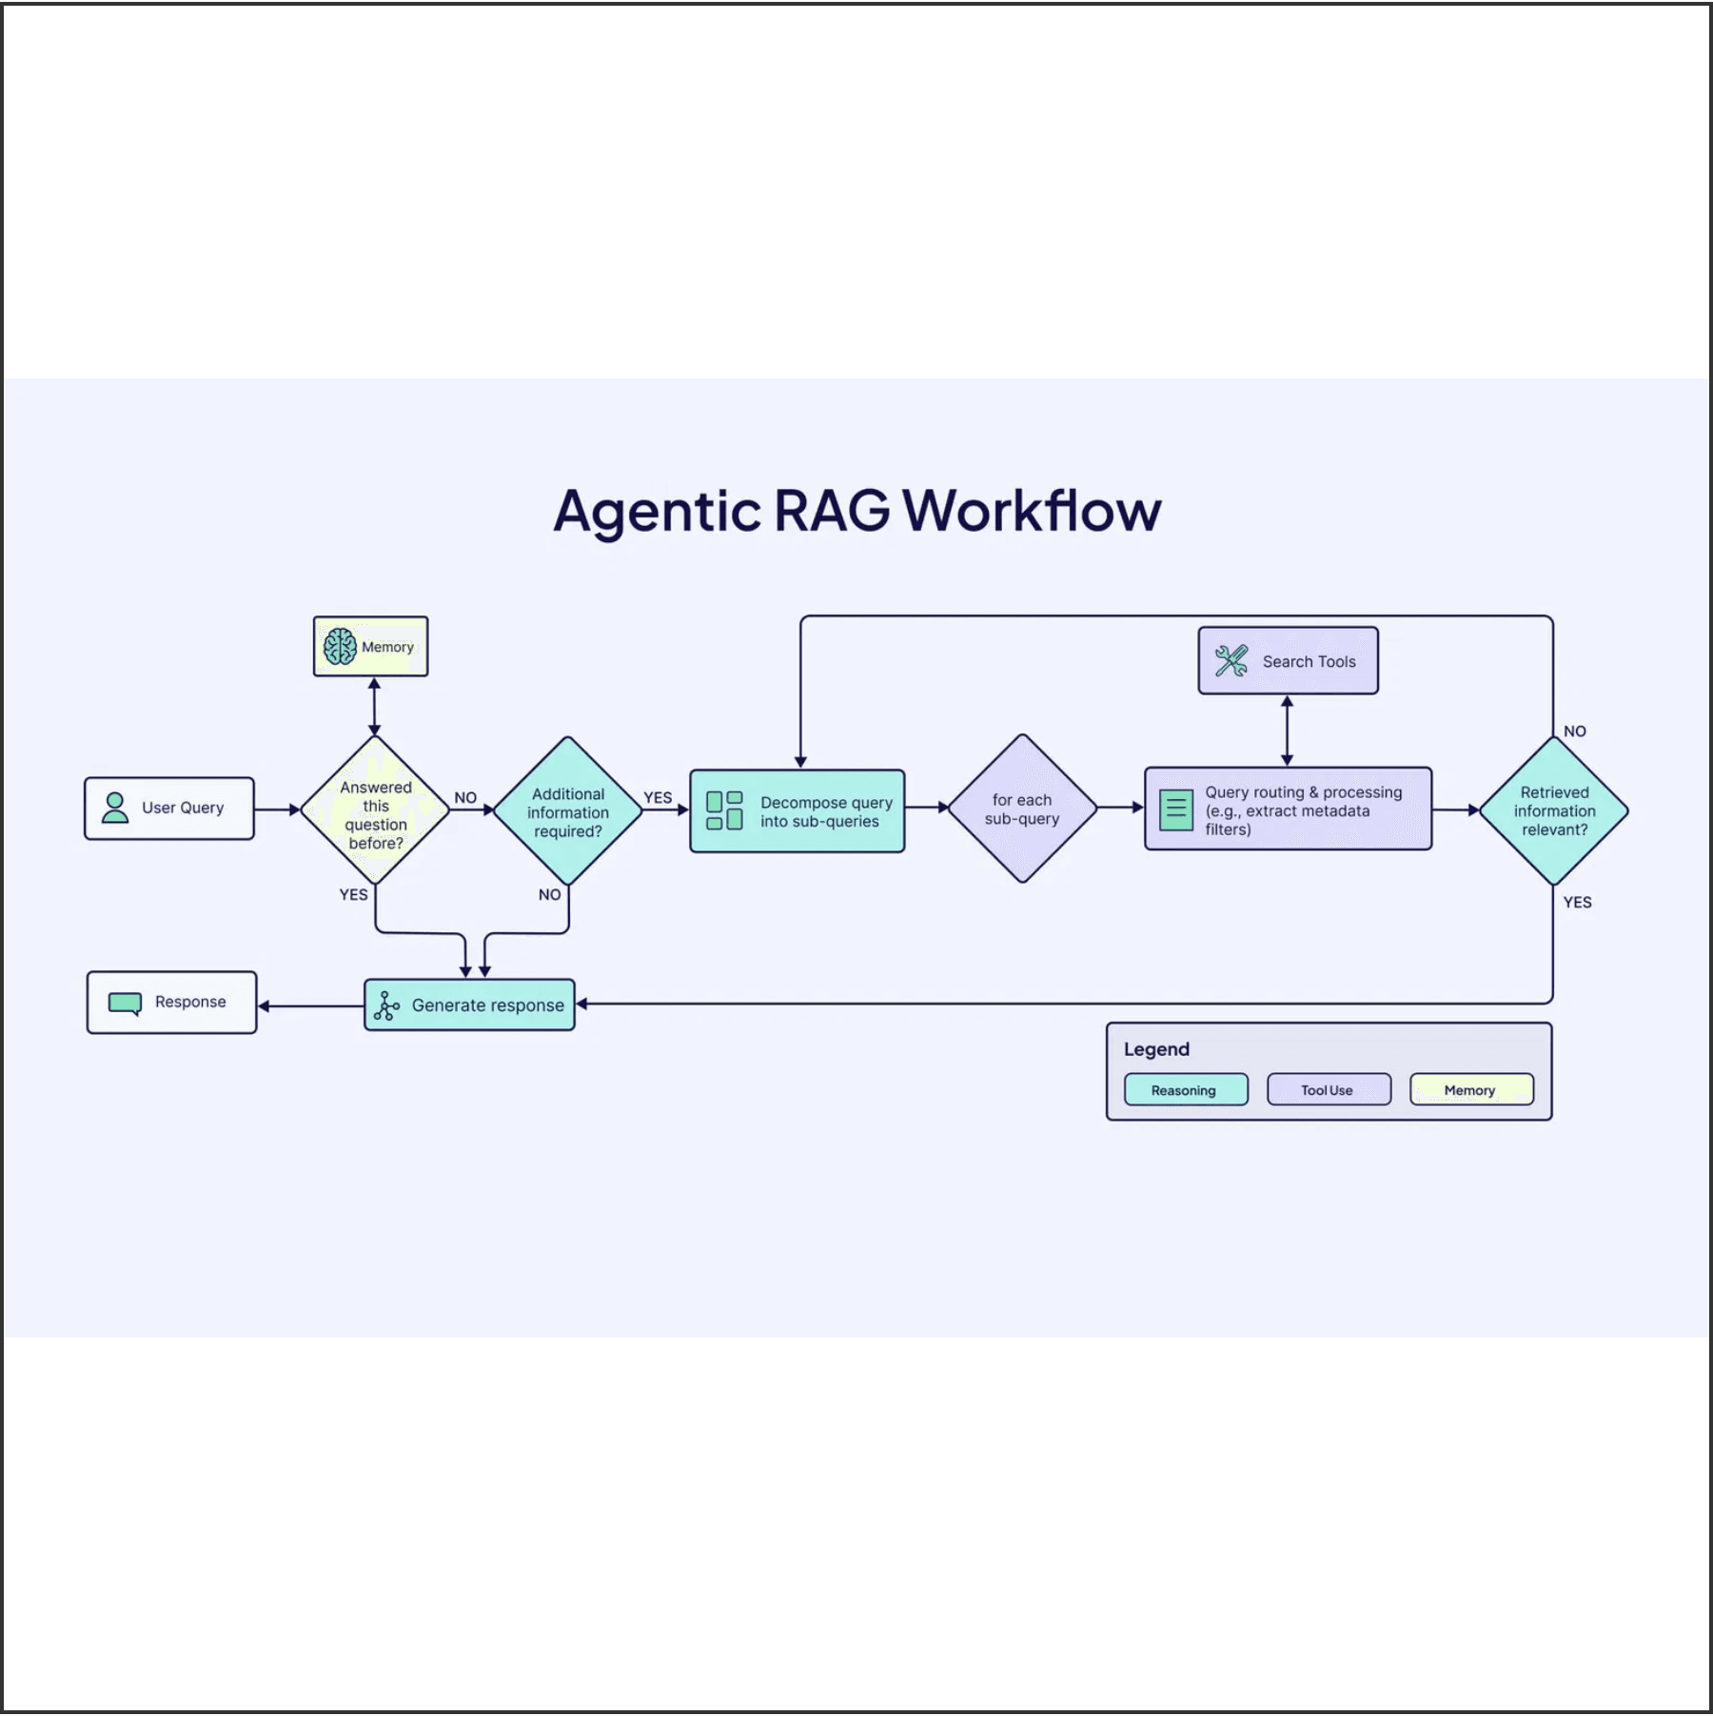
A Modular Architecture Enables Autonomous Perception and Action
Perception
Brain (Reasoning)
The entry point where agents ingest and interpret multi-modal data from user queries, APIs, and sensors.
The central processing unit that evaluates information and makes decisions based on goals.
Planning
Action
The ability to decompose complex objectives into a sequence of manageable sub-tasks and dependencies.
The execution layer where the agent interacts with the digital or physical world via tool calling and APIs.

Slide 4
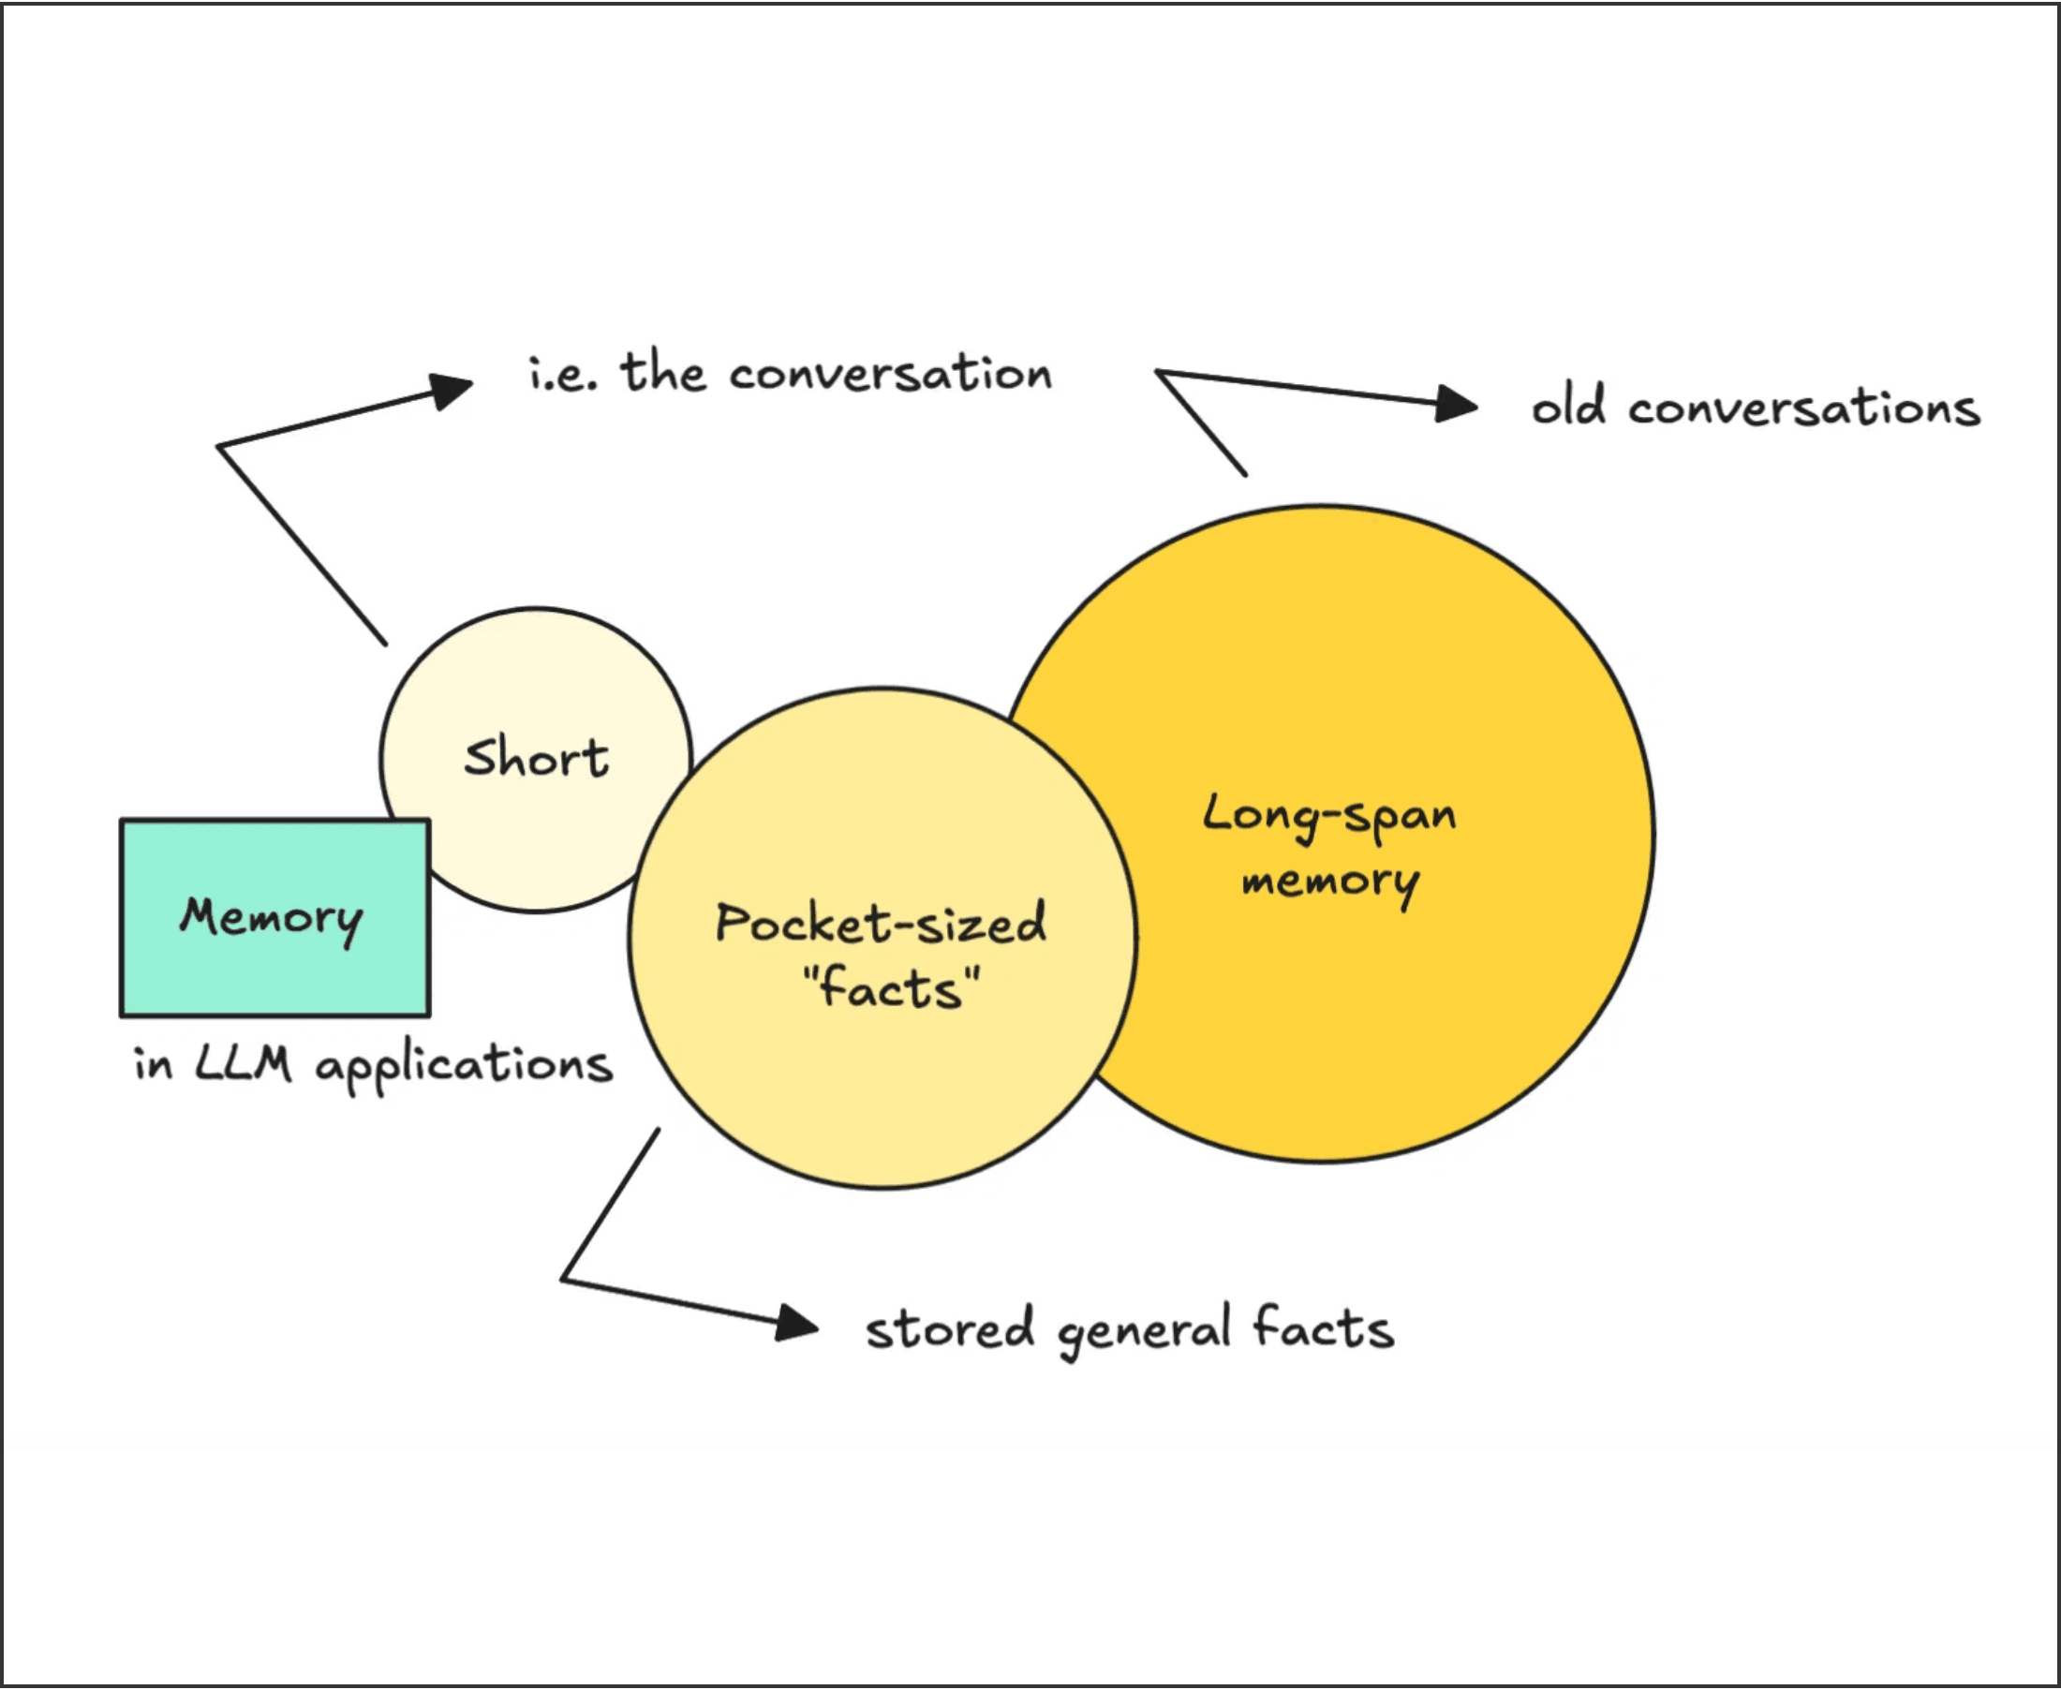
Persistent Memory Provides Contextual Continuity and Long-term Learning
Short-term Memory
Utilizes the model's context window to maintain session-based coherence and "in-context learning" for immediate tasks.
Long-term Memory
Leverages vector databases and external knowledge bases to store and retrieve historical data across multiple sessions.
Contextual Awareness
Memory allows agents to recall past user preferences, previous errors, and successful strategies, moving beyond stateless interactions.

Slide 5

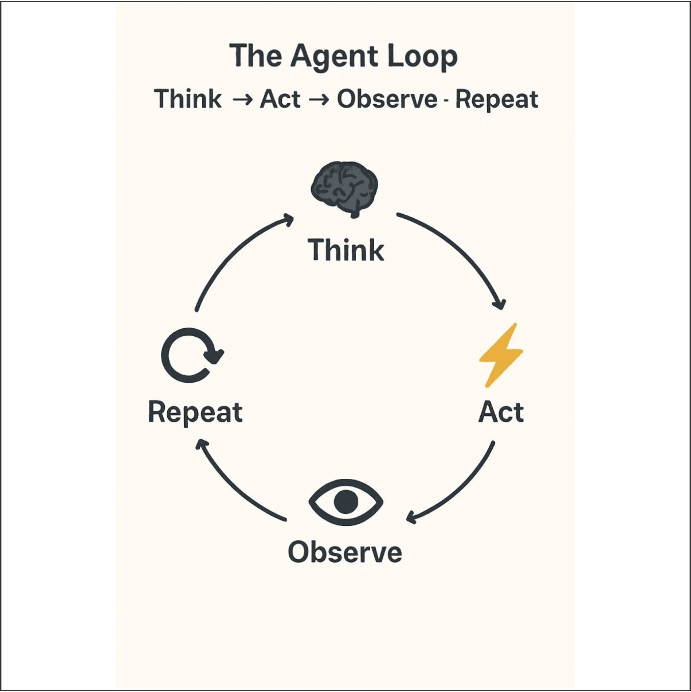
ReAct Interleaves Reasoning and Action for Dynamic Problem Solving
The Core Mechanism
The agent follows a "Think -> Act -> Observe" loop, generating explicit reasoning (Thought) before executing a tool call (Action) and receiving feedback (Observation).
Dynamic Flexibility
Highly adaptive to real-time feedback; the agent can pivot its strategy or correct errors based on the immediate observation of a tool's output.
Optimal Use Cases
Ideal for interactive tasks where the environment is unpredictable or requires step-by-step validation, such as complex research or troubleshooting.
Operational Trade-offs
The sequential nature of the loops results in higher latency and increased token consumption compared to non-iterative approaches.

Slide 6

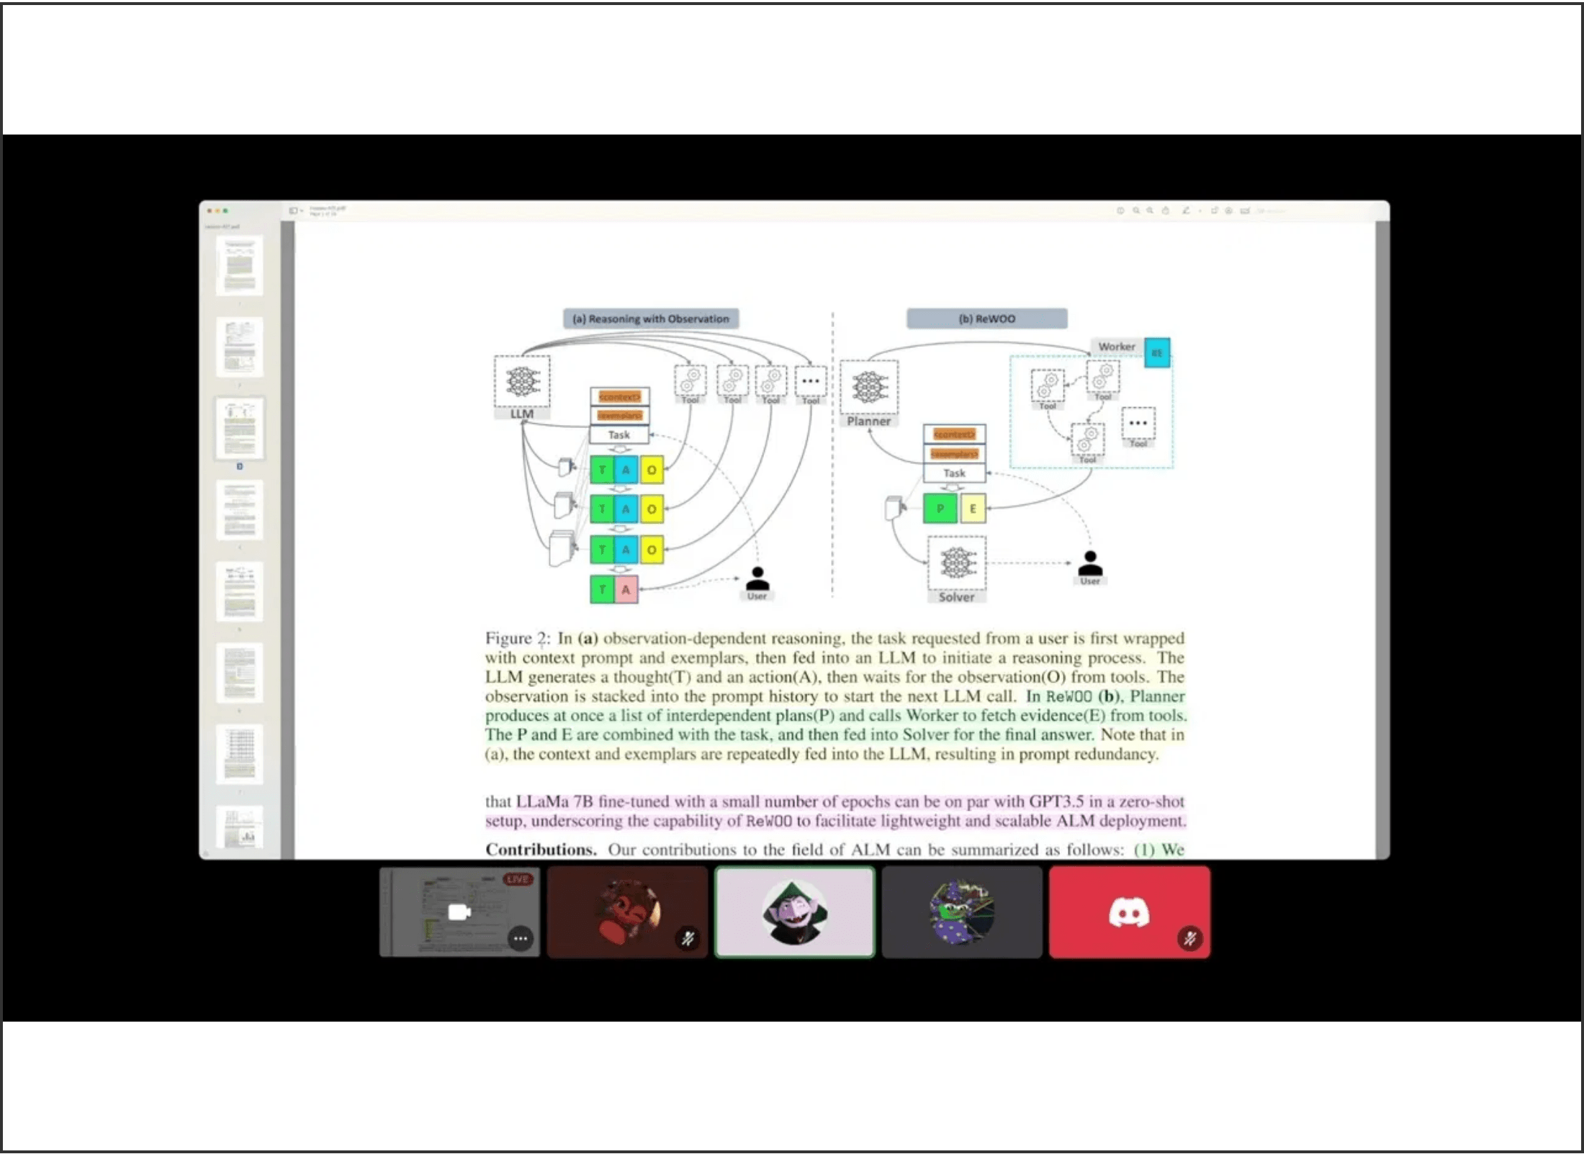
ReWOO Optimizes Efficiency by Decoupling Reasoning from Observation
Efficiency Paradigm
The "Reasoning WithOut Observation" paradigm plans the entire execution blueprint upfront with placeholders for results, enabling parallel tool execution.
Planner
Generates a comprehensive blueprint of steps and tool calls without waiting for intermediate outputs.
Worker
Executes all planned tool calls in parallel, significantly reducing total system latency.
Solver
Synthesizes the final response by populating the initial plan with the collected tool results.

Slide 7

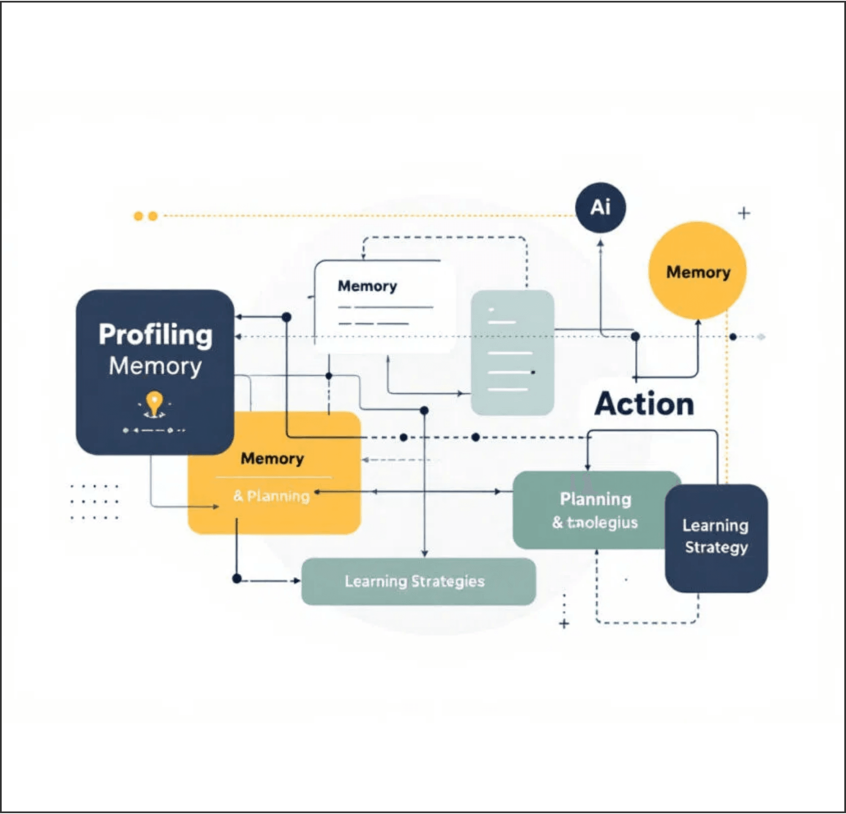
Standardized Patterns Drive Reliability in Autonomous Workflows
Reflection
A self-correction pattern where the agent critiques its own output and iterates to improve quality and accuracy.
Tool Use
Equipping agents with specialized APIs (search, calculators, databases) to extend capabilities beyond native knowledge.
Planning
Focuses on goal decomposition and dynamic re-planning when obstacles or new information are encountered.
Multi-Agent Collaboration
Distributing complex tasks across specialized agents (e.g., Researcher and Writer) to maximize performance.

Slide 8

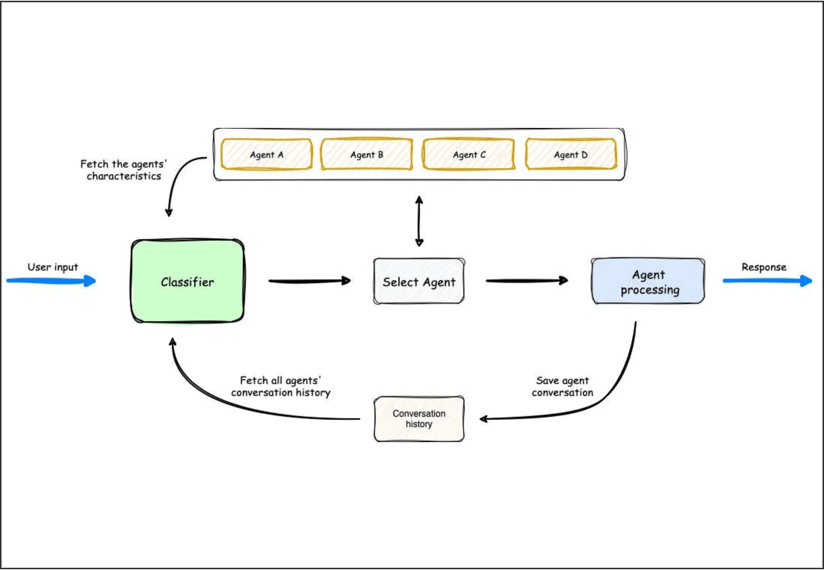
Specialized Agent Collectives Outperform Single Monolithic Models
Role Specialization
Assigning specific personas and tools to different agents minimizes "distraction" and maximizes accuracy for complex, multi-domain tasks.
Orchestration & Coordination
A lead agent or manager coordinates the workflow, delegating tasks to specialized sub-agents and synthesizing their outputs into a cohesive result.
Collaborative Intelligence
Agents can peer-review each other's work, leading to higher quality, reduced hallucination rates, and more robust problem-solving capabilities.
Fig 1.0: Multi-Agent Orchestration Architecture

Slide 9

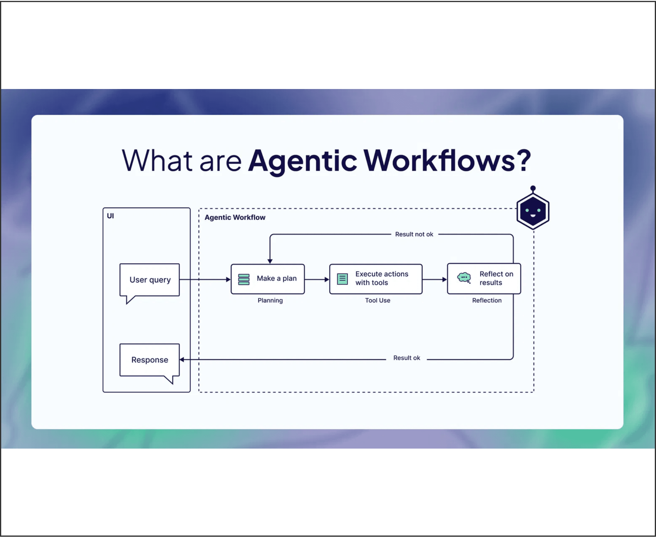
Agentic RAG Dynamically Navigates Knowledge for Precision Answers
Beyond Simple Retrieval
Traditional RAG is a linear process that often fails on complex queries. Agentic RAG introduces dynamic decision-making into the retrieval loop.
Dynamic Search Strategy
The agent decides what to search for, where to search, and whether the retrieved information is sufficient to answer the query.
Multi-Hop Reasoning
The agent can perform iterative searches, using findings from one step to inform the next, effectively connecting disparate pieces of information.
Verified Grounding
Ensures the final generation is grounded in the most relevant and verified data available, significantly reducing hallucination rates.

Slide 10

The Future of AI is Agentic, Autonomous, and Integrated
Digital Employees
Robust Foundations
Agentic Ecosystems
Agentic workflows are the key to moving AI from simple "chatbots" to capable "digital employees" that execute end-to-end processes.
Success depends on the integration of robust planning, sophisticated memory management, and specialized reasoning paradigms like ReAct and ReWOO.
The next frontier lies in seamless multi-agent ecosystems that operate autonomously across entire organizations, driving unprecedented efficiency.
Transforming passive intelligence into active autonomy.

Slide 11

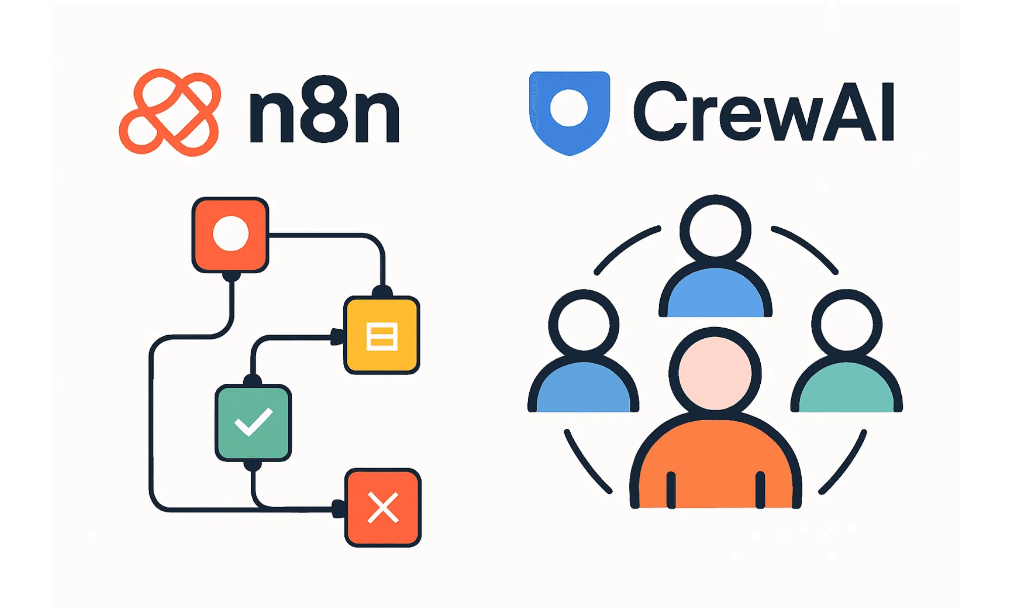
n8n
Modern frameworks bridge the gap between theory and production
A low-code powerhouse for integrating agents into existing enterprise workflows via 400+ native integrations.
CrewAI
A code-centric framework designed for role-playing and collaborative multi-agent orchestration.
Selection Criteria
Use n8n for workflow-heavy tasks; use CrewAI for complex, autonomous reasoning tasks.
Notes:
We've covered the theory, the architecture, and the necessary governance. Now we look at the tools that bridge the gap between agentic theory and production reality. n8n and CrewAI represent two distinct approaches to building agentic systems. n8n is a low-code powerhouse, excellent for integrating agents into existing enterprise workflows. With over 400 native integrations, it's the perfect choice for workflow-heavy tasks that need to connect to your CRM, ERP, or email systems. CrewAI, on the other hand, is a code-centric framework designed specifically for collaborative multi-agent orchestration. It excels at defining roles and creating a virtual department of specialized agents for complex reasoning tasks. Your selection criteria should be clear: use n8n for connecting workflows, and use CrewAI for building autonomous, complex reasoning teams. These tools are what enable the future we've been discussing.

Slide 12

Strategic Next Steps
The future of work is a collaborative partnership
01. Start Small
Identify low-risk, high-frequency tasks for initial agentic automation.
02. Define Boundaries
Establish clear action scopes and human-in-the-loop checkpoints.
We have moved from simple content generation to autonomous, goal-oriented systems. The goal is not to replace humans, but to augment our capabilities and handle the complexity of modern workflows.
03. Focus on Value
Prioritize use cases that deliver measurable efficiency and reliability gains.
Agentic AI Masterclass • 2025 • End of Session
Notes:
We've reached the end of our masterclass, and the core takeaway is clear: the future of work is a collaborative partnership between humans and agents. We have moved decisively from simple content generation to autonomous, goal-oriented systems that can plan and execute. The goal is not human replacement, but augmentation, handling the complex drudgery of modern workflows. To start implementing this, you must follow three strategic steps. First, start small by identifying low-risk, high-frequency tasks for initial automation. Second, define clear boundaries and establish human-in-the-loop checkpoints. And third, focus relentlessly on value by prioritizing use cases that deliver measurable efficiency gains. The most successful organizations will be powered by these agentic ecosystems. Thank you for your time.

Slide 13
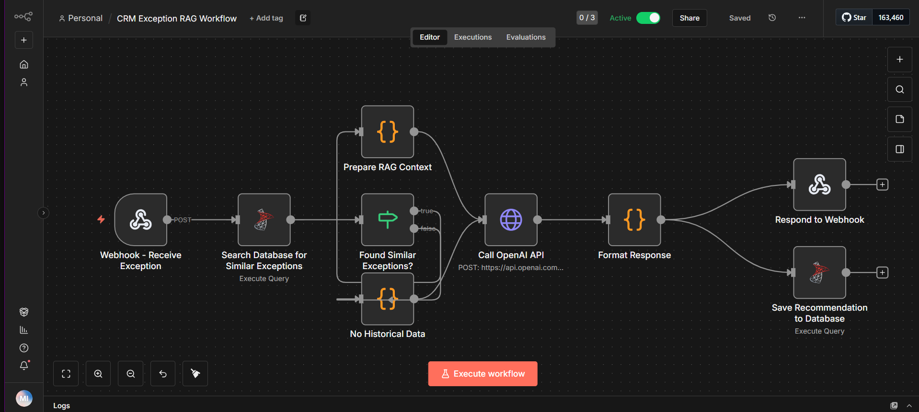
CRM Exception RAG Workflow – n8n

Slide 14
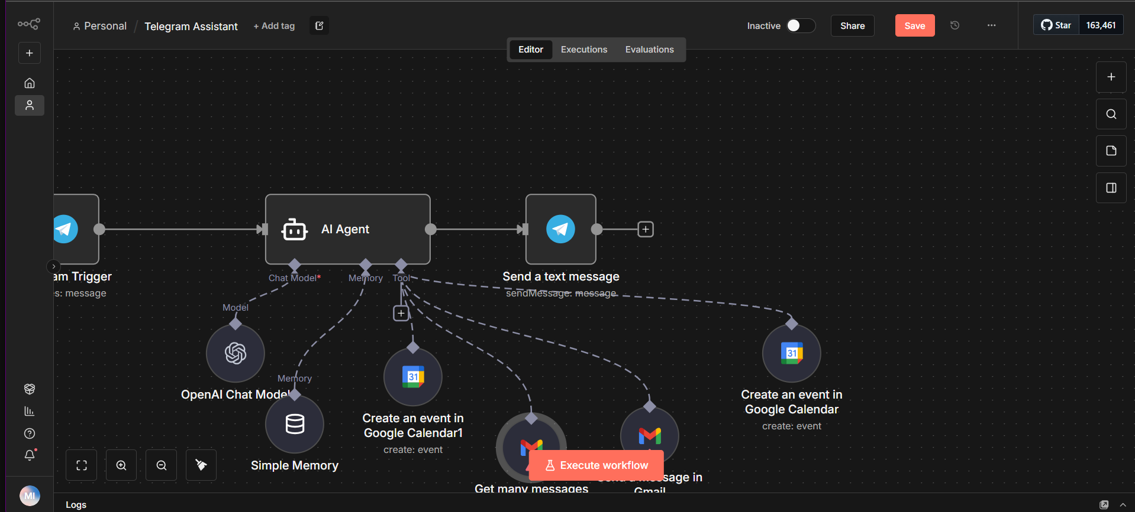
Telegram Assistant – n8n

Slide 15
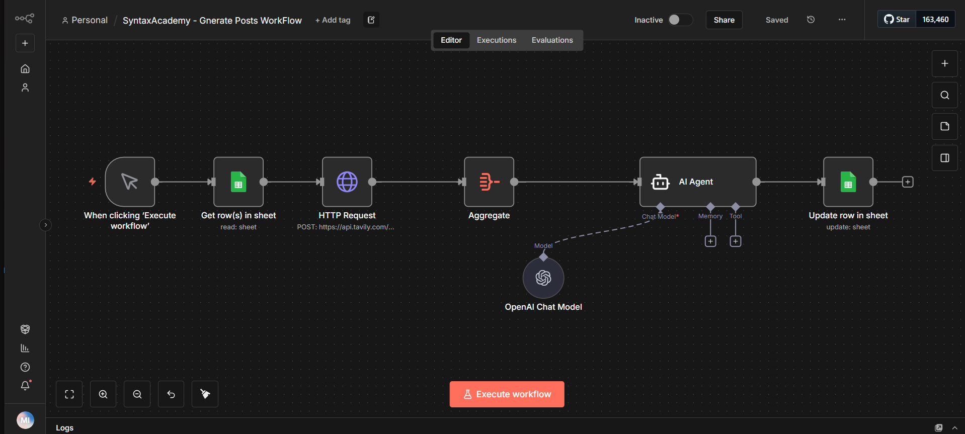
SyntaxAcademy - Generate Posts Workflow – n8n

Slide 16
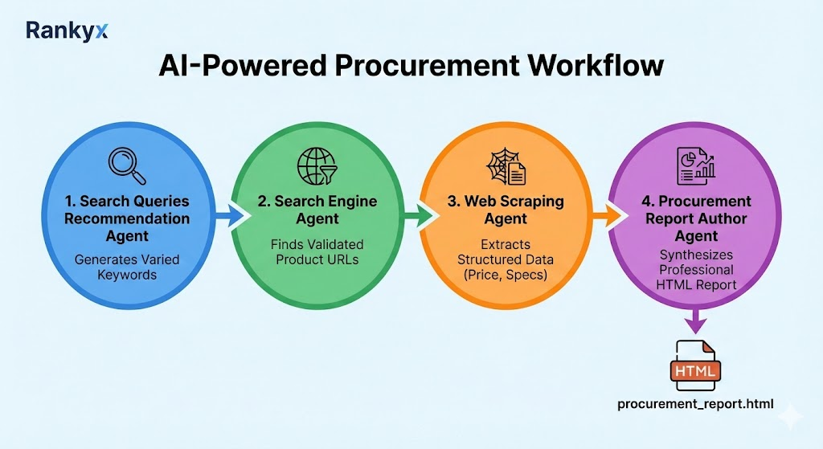
AI Agent Crew AI

